Slide 1
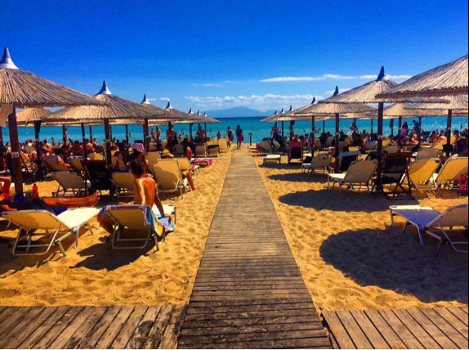
Host Behaviour Analysis For Property Rental Company

Slide 2

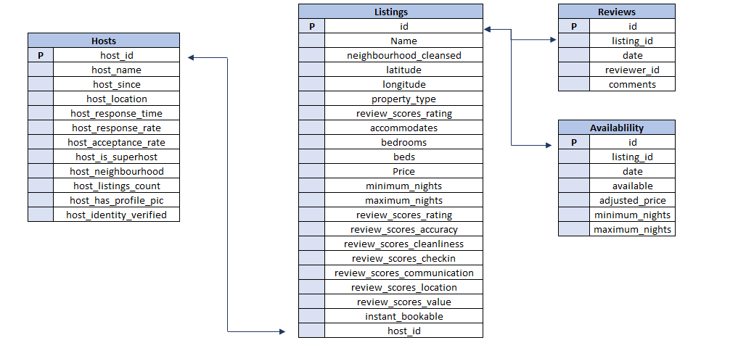
DATA OVERVIEW

Slide 3

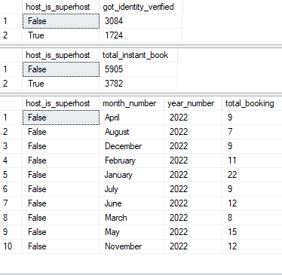
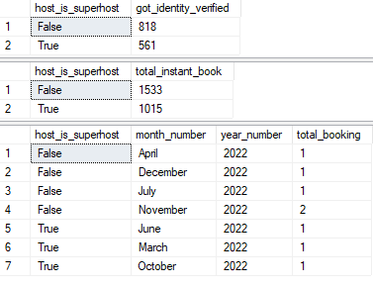
Different metrics to give the insight between Super Host and Other Hosts on instant booking, identity verified and average number of bookings
True=Super Host
False=Host
Athens Thessaloniki

Slide 4
Top 3 crucial metrics one needs to maintain to become a Super Host
True=Super Host
False=Host
Athens Thessaloniki
If avg_response is more than 77, than the probability to become Superhost is higher
If avg_acceptance is more than 72, than the probability to become superhost is higher
If avg_response is more than 83, than the probability to become superhost is higher
If avg_acceptance is more than 82, than the probability to become superhost is higher

Slide 5
Athens Thessaloniki
If avg_rating is more than 4.5, than the probability to become superhost is higher
If avg_rating is less than 3.4, than the probability to become superhost is very less
If avg_rating is more than 4.6, than the probability to become superhost is higher
If avg_rating is less than 3.6, than the probability to become superhost is very less

Slide 6
Common Insight
avg_acceptance of superhost in Thessaloniki is 10% more than that of Athens
avg_response of superhost in Thessaloniki is 5% more than that of Athens In both the cities , if avg_response is more than 80, avg_acceptance is more than 75 and rating is more than 4.5 , than their are huge chances that host can become a superhost
avg_acceptance of host in Thessaloniki is 23% more than that of Athens
avg_response of host in Thessaloniki is 21% more than that of Athens
These insights plays a vital role for any HOST to become a SUPERHOST

Slide 7
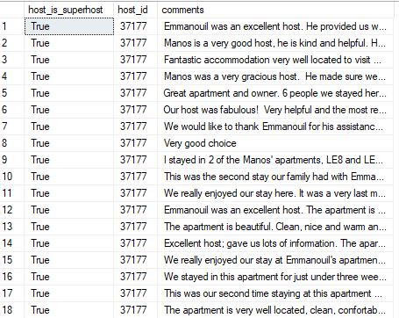
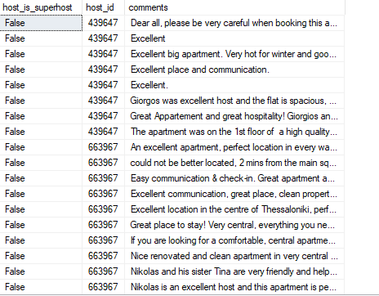
Comments of reviewers vary for listings of Super Hosts vs Other Hosts Athens Thessaloniki
Super Host
Host

Slide 8
Super Hosts tend to have large property types as compared to Other Hosts
The property which have more than 7 accommodates are considered as large property (L)
The property which have less than or equal 7 accommodates are considered as small property
Athens Thessaloniki
3.92% of host have large property and 3.78% of superhost have large property so we can say that size of property does not play a big role in making superhost
5.14% of host have large property and 3.80% of superhost have large property so we can say that size of property does not play a big role in making superhost

Slide 9
Average price and availability of the listings for the upcoming year between Super Hosts and Other Hosts Athens Thessaloniki

